Slide 1
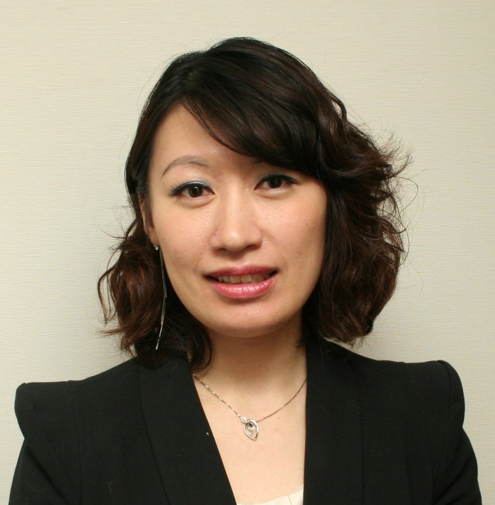
Motives全新春夏彩妝品
Motives New Products
Emmy Yeung
產品拓展經理
Product Manager

Slide 2

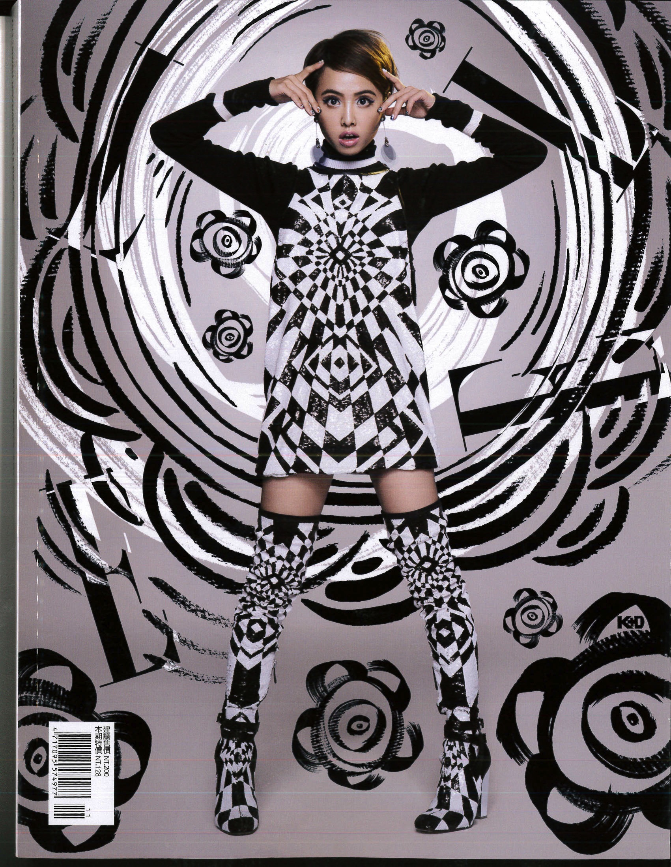
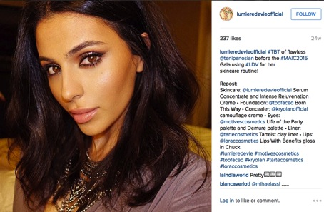

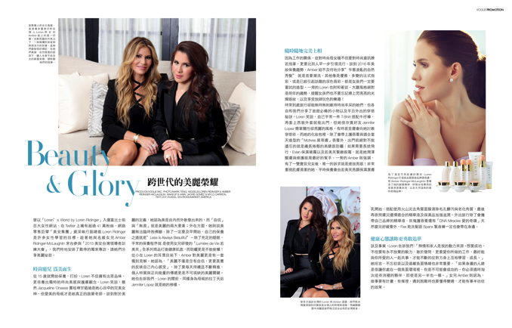
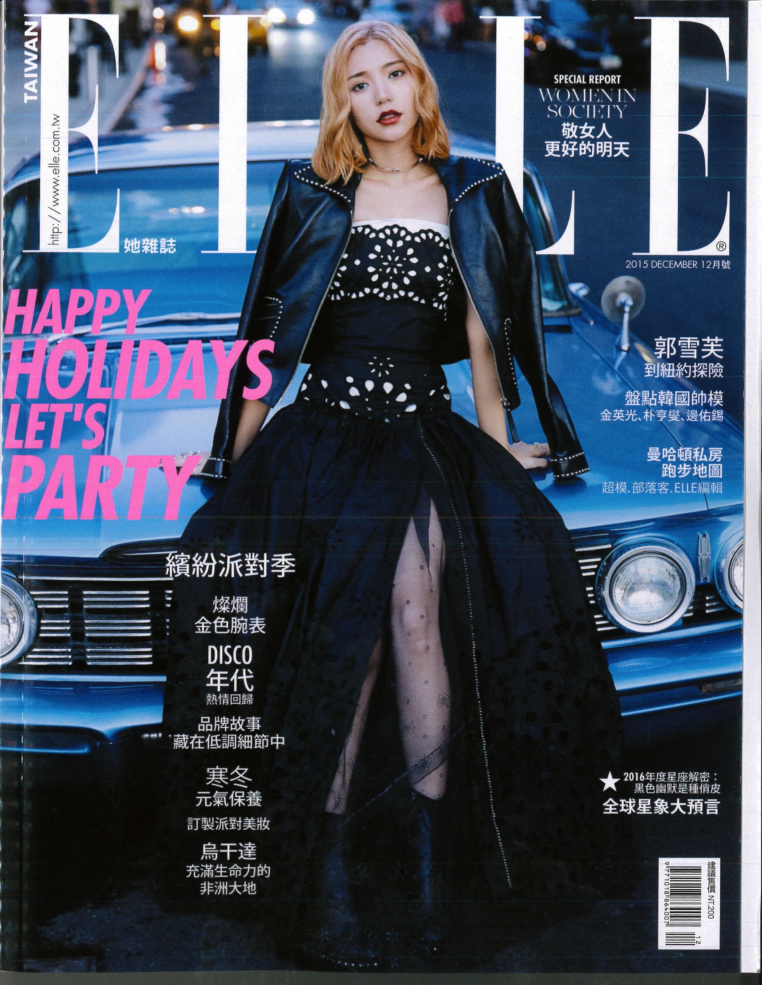
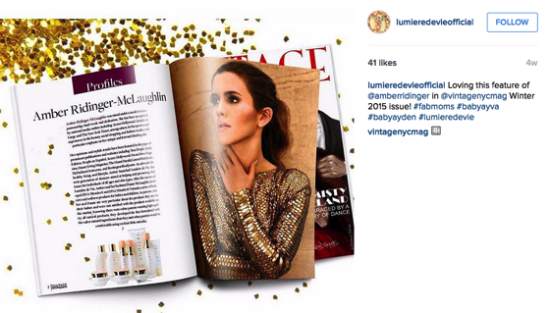




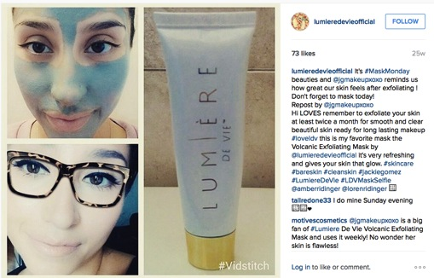

Slide 3
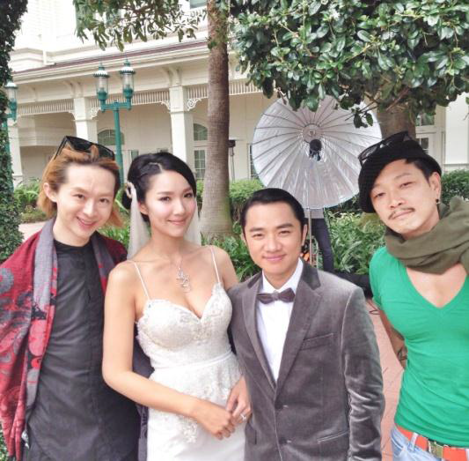
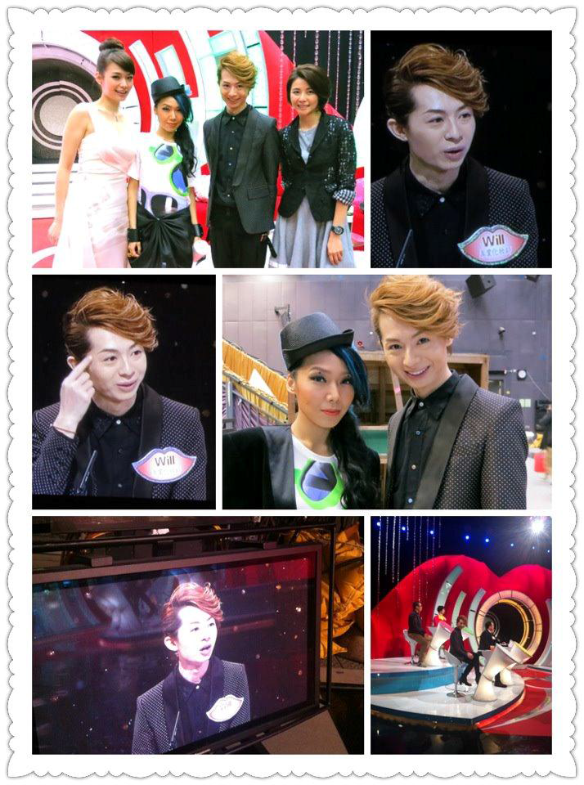
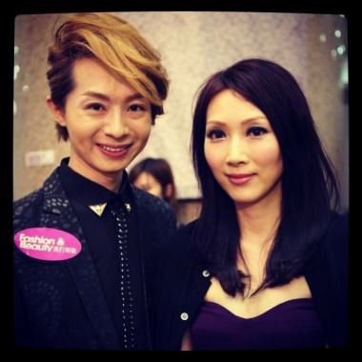
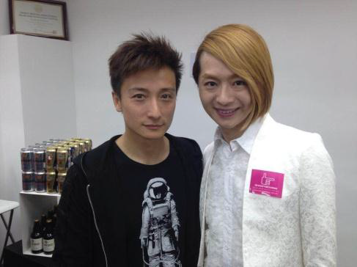
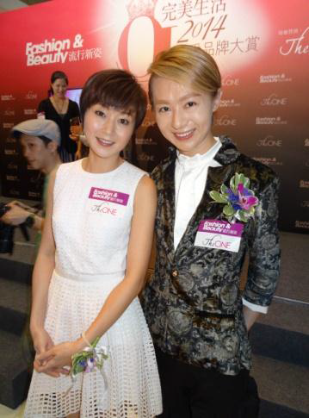
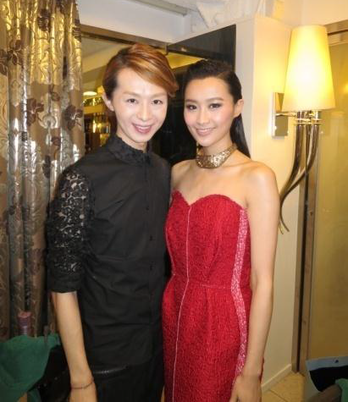
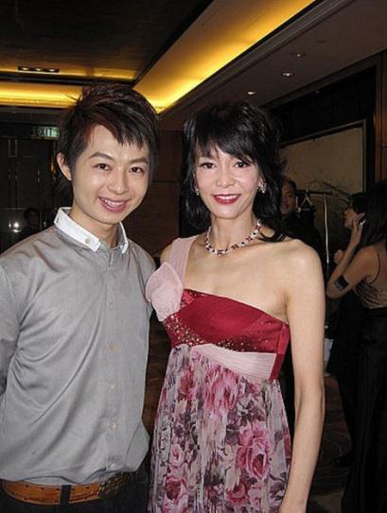
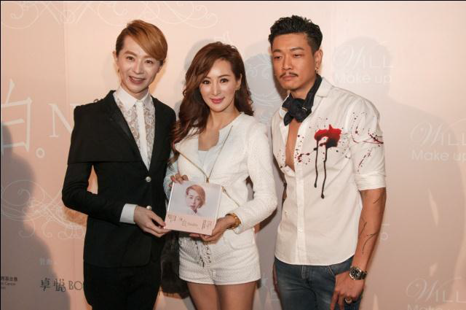
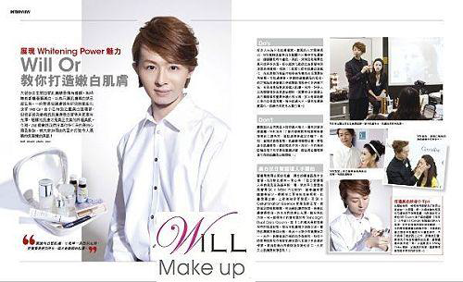

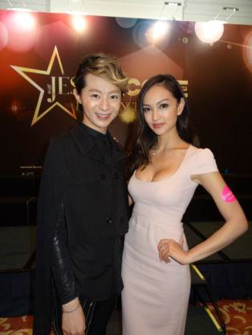
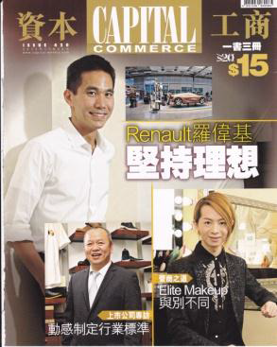
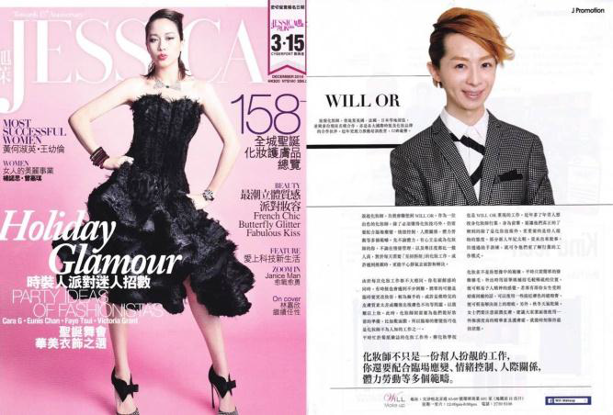


Slide 4
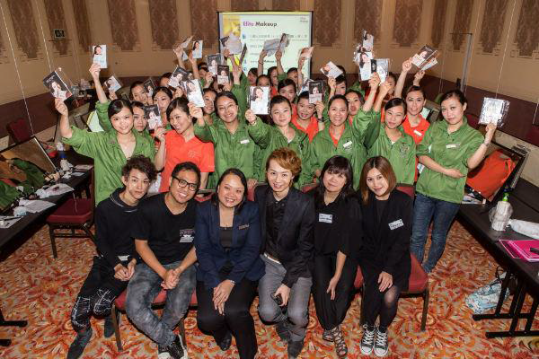

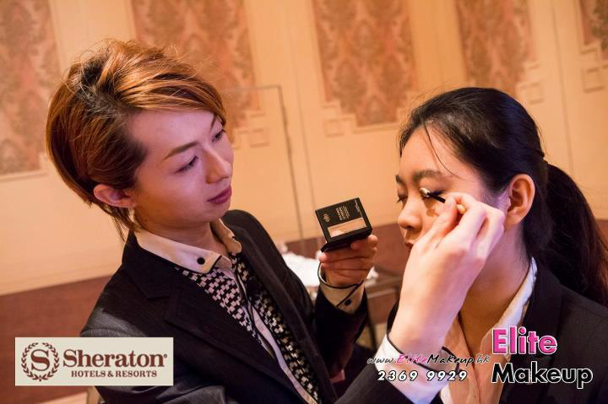
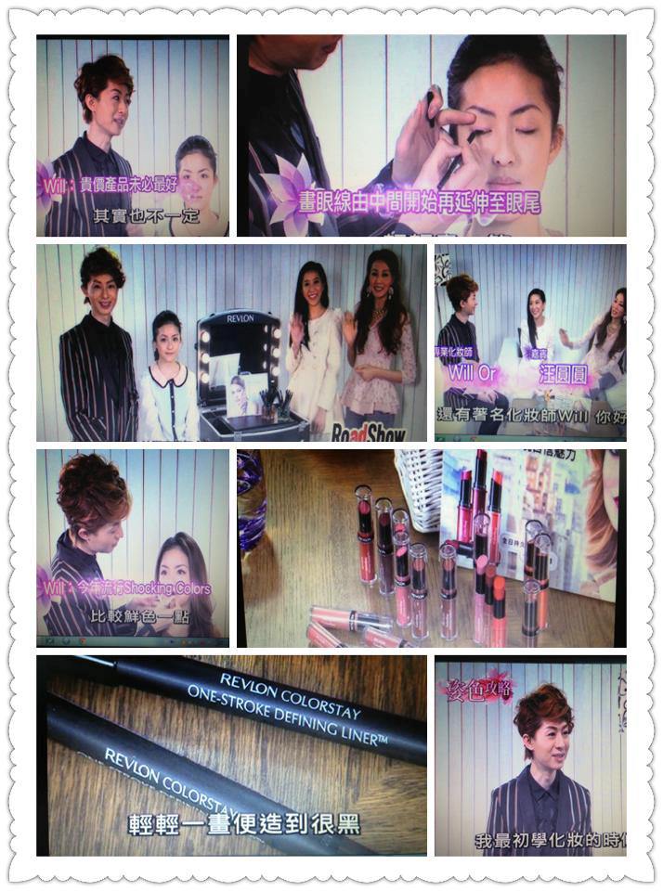
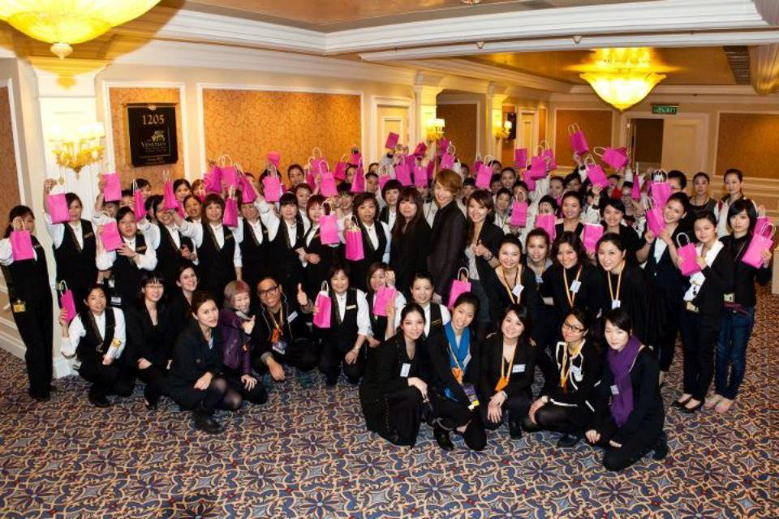
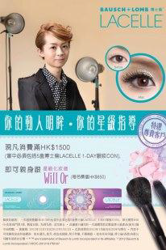
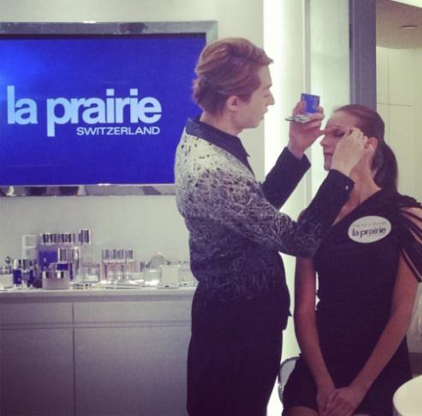
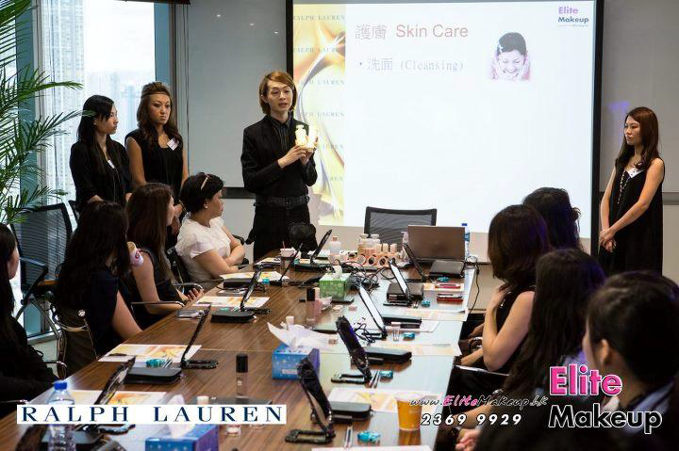

Slide 5
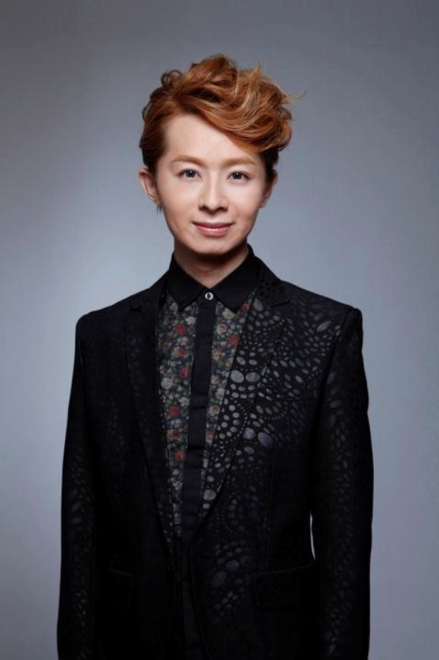
WILL OR
星級化妝師
Professional Makeup Artist

Slide 6
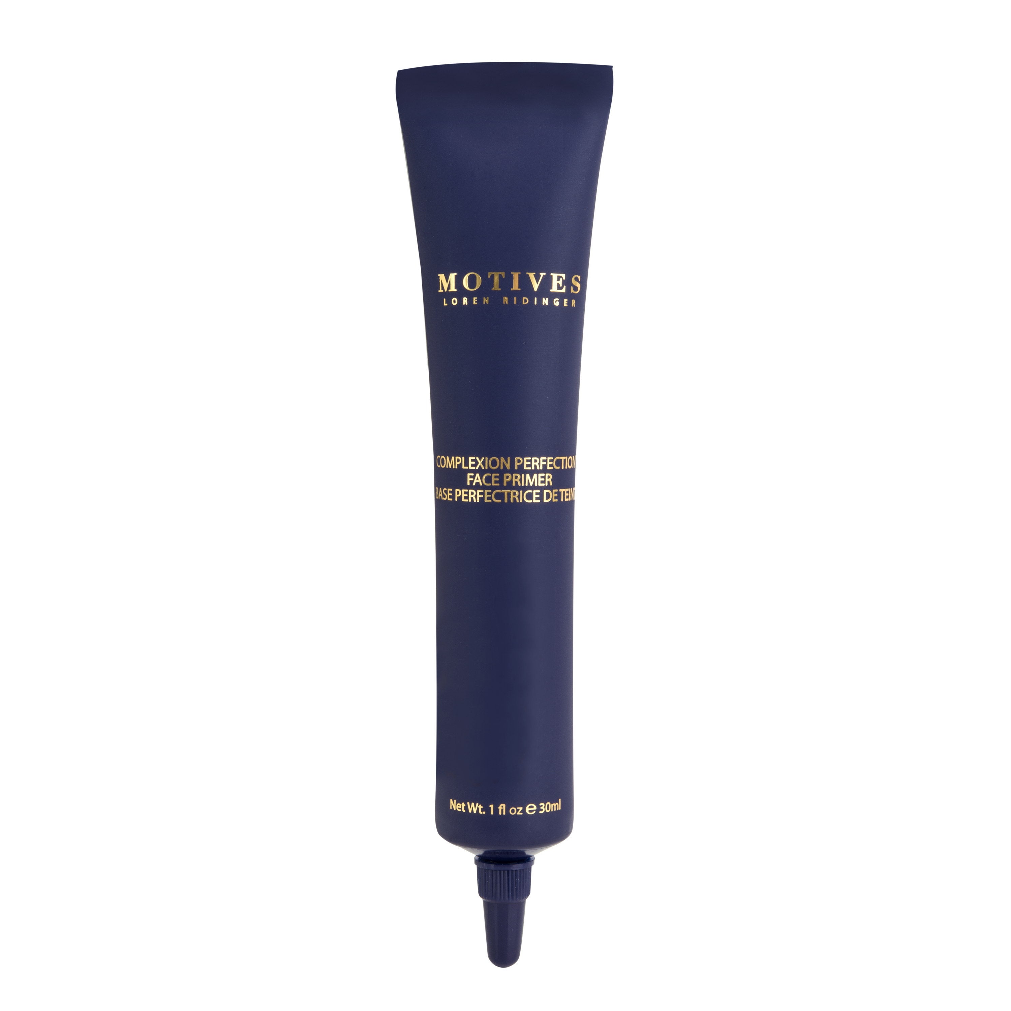
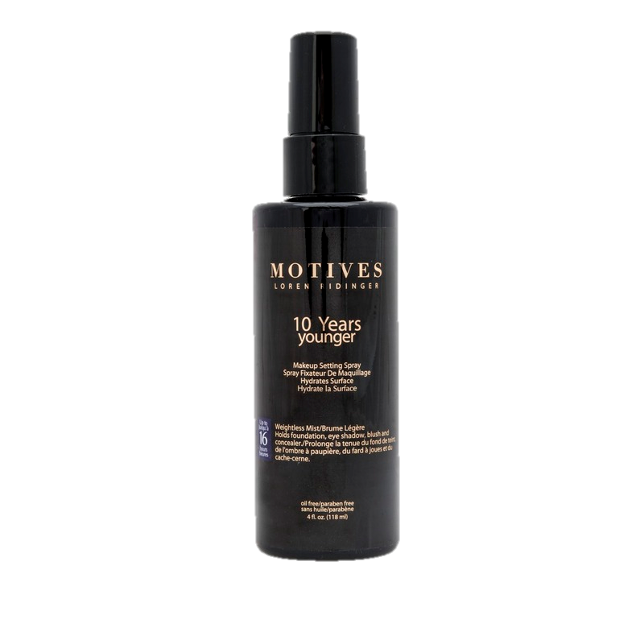
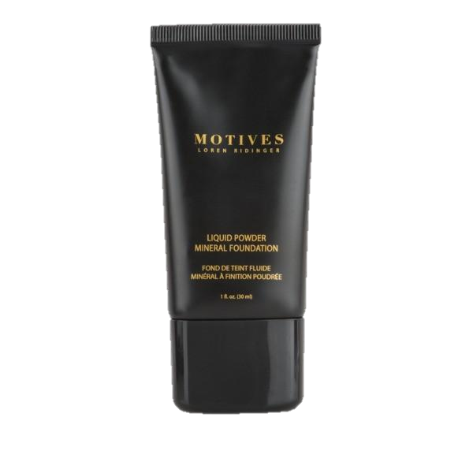
Will Or’s最喜愛的彩妝品
Favorite Cosmetic Products From Motives
無瑕美肌妝前底霜
Face Primer
礦物粉底液
Mineral Foundation
瞬間無瑕定妝噴霧
Makeup Setting Spray

Slide 7
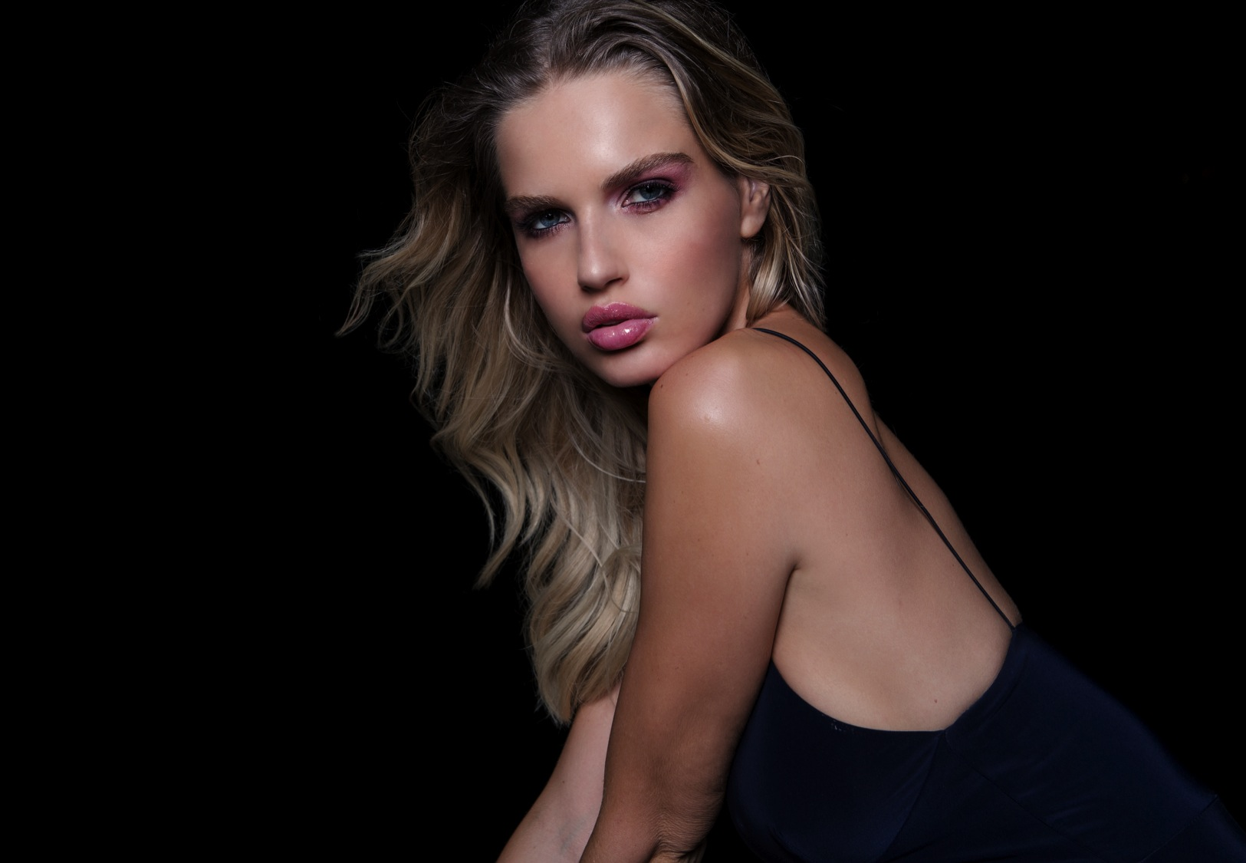

SPRING
SUMMER
2016

Slide 8
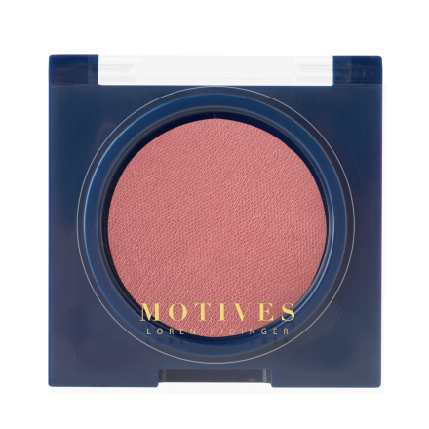
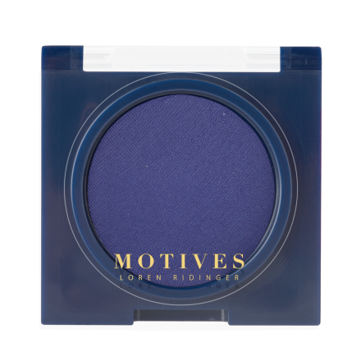
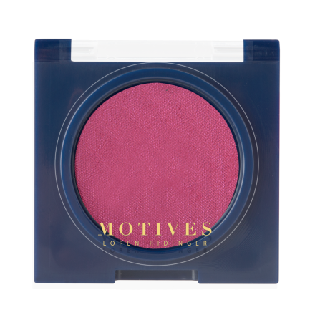

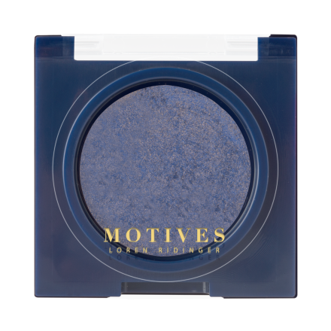

Motives®眼影Pressed Eye Shadow
& Motives®瑰麗眼影Eye Illusions
Paper Doll
HK191MES
Deep End
HK206MES
Wildflower
HK214MES
SPRING | SUMMER
2016
Rapture
HK100MEIS
Fiction
HK101MEIS
Celestial
HK107MEIS
眼影 PRESSED EYE SHADOW
瑰麗眼影 EYE ILLUSIONS
UC:$95.00 SR:$133.00 BV:7.75
UC:$124.00 SR:$173.00 BV:11

Slide 9
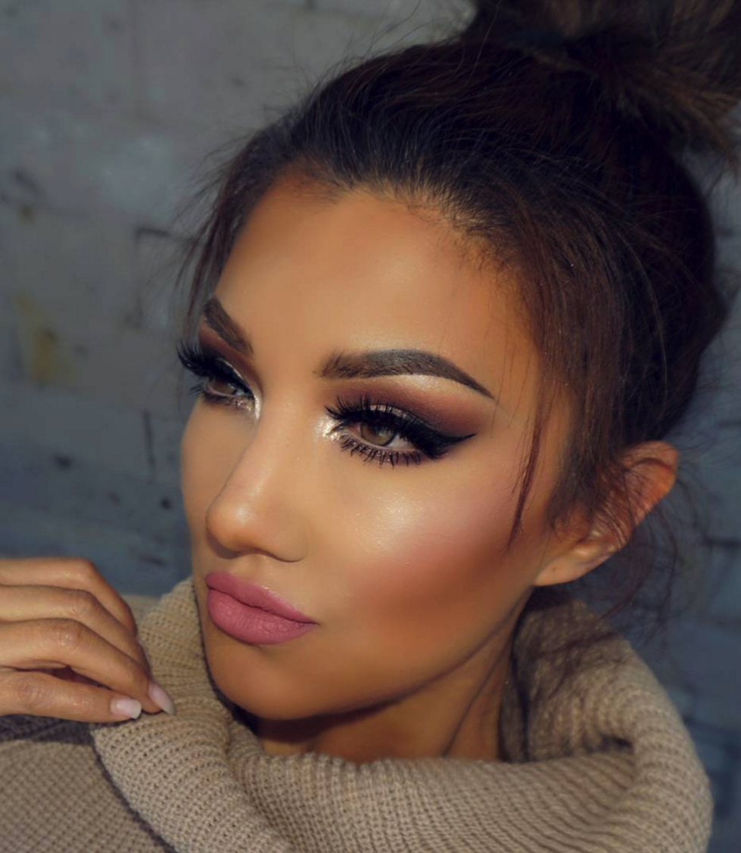




Motives® Maven晶鑽閃粉
GEM SPARKLES
MORGANITE | HK10GEMS
ZIRCONIA | HK11GEMS
CITRINE | HK12GEMS
UC: $124.00 | SR:$172.00 | BV:11.50

Slide 10
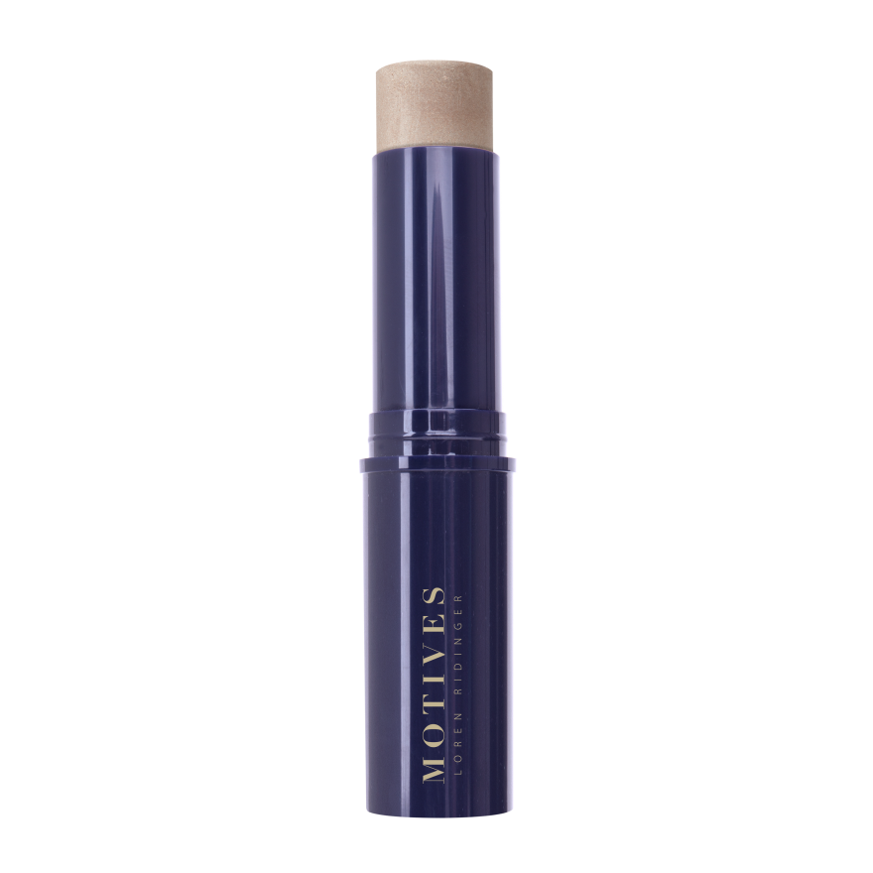
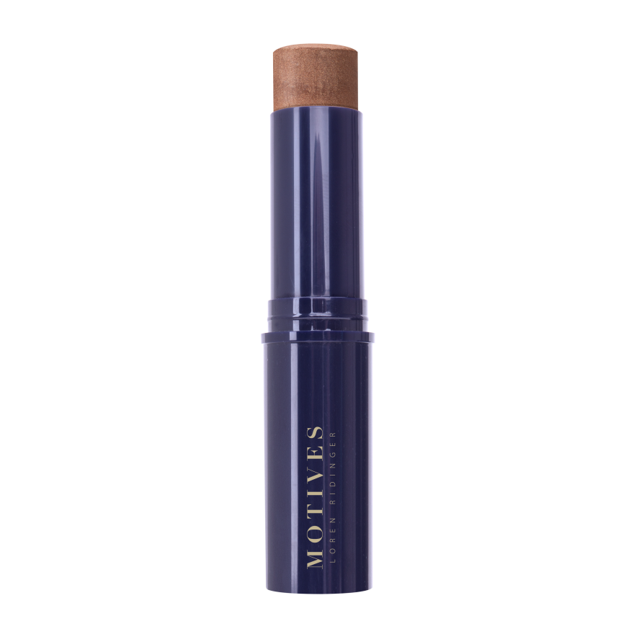
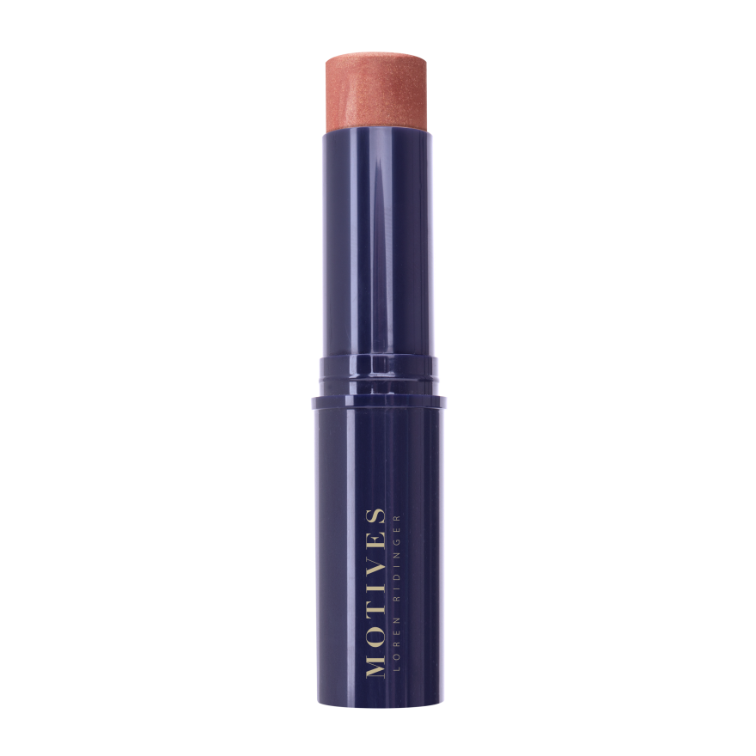
Motives®立體修容筆
Shimmer Stick
Nocturnal Heat
224MES
Moonlight
HK200MSS
Island Glow
HK202MSS
SPRING | SUMMER
2016
Sunkissed
HK201MSS
UC:$139.00 SR:$193.00 BV:12

Slide 11
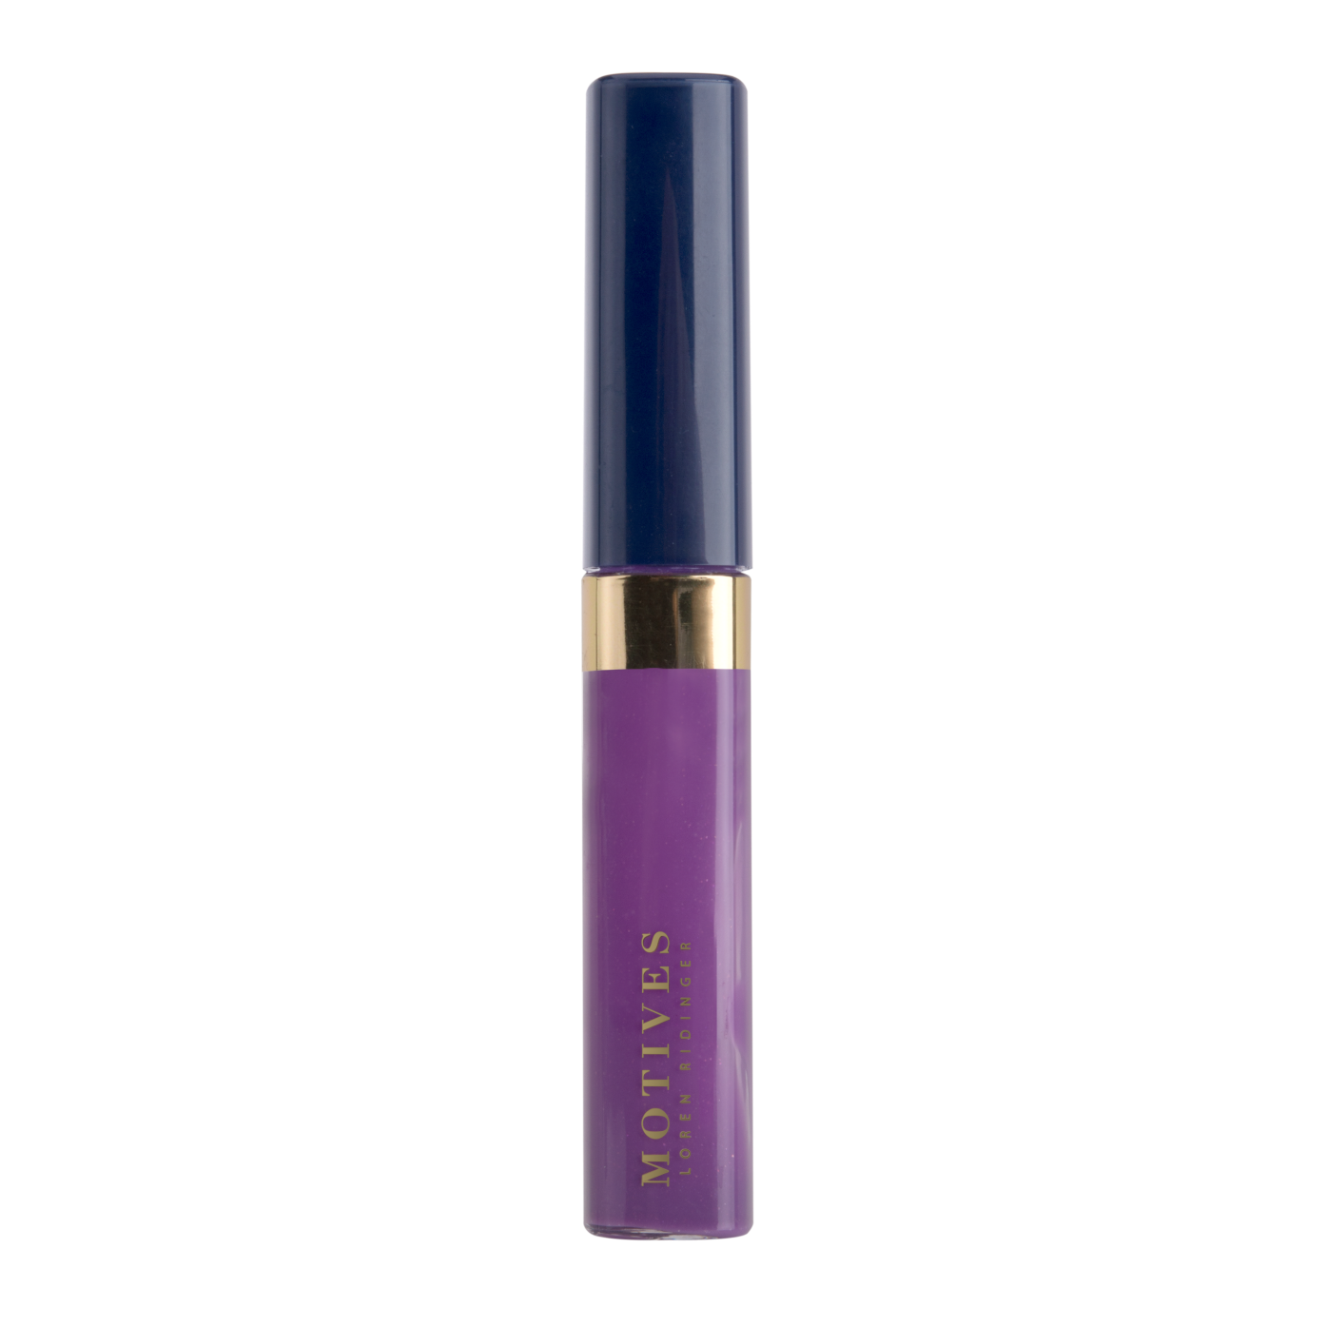
Motives®礦物唇彩
Mineral Lip Shine –
Wildflower
Nocturnal Heat
224MES
SPRING | SUMMER
2016
UC:$125.00 SR:$175.00 BV:9.75

Slide 12
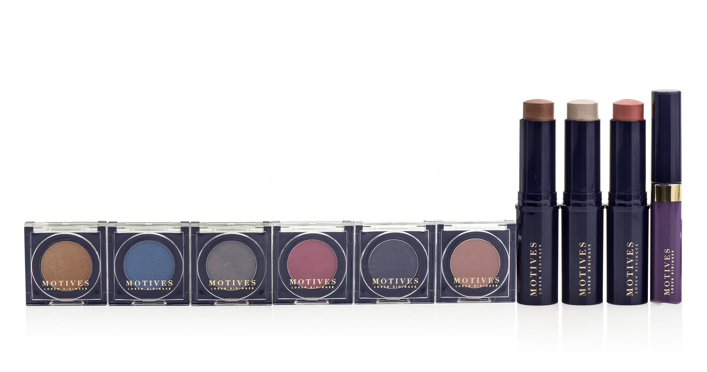
Motives®春夏彩妝組合
Spring and Summer
Color Collection Kit
SAVE
10%
Nocturnal Heat
224MES
SPRING | SUMMER
2016
UC:$1,075.00 SR:$1,500.00 BV:85.00

Slide 13
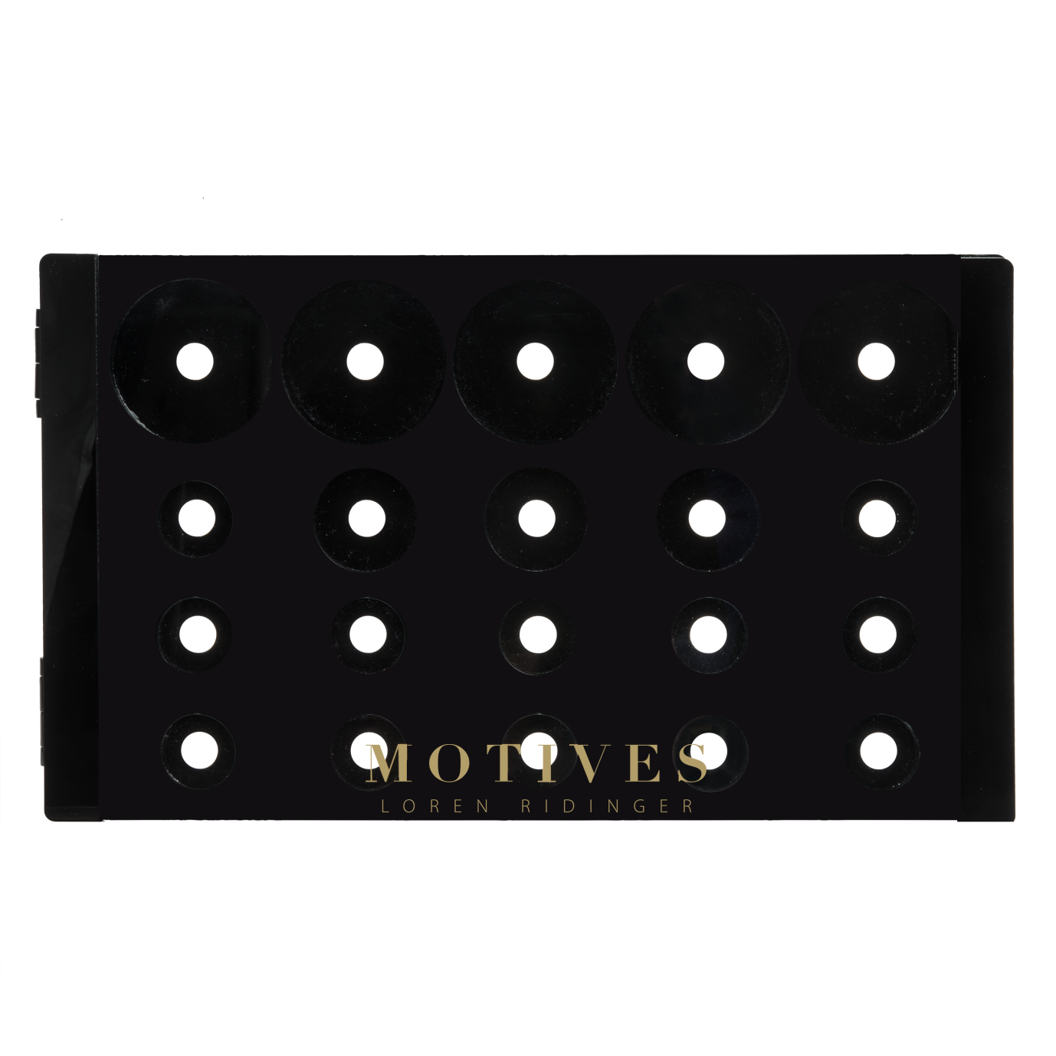
Motives®專業彩妝盒
Empty Consultant Palette
Nocturnal Heat
224MES
SPRING | SUMMER
2016
UC:$398.00 SR:$398.00 BV:0

Slide 14
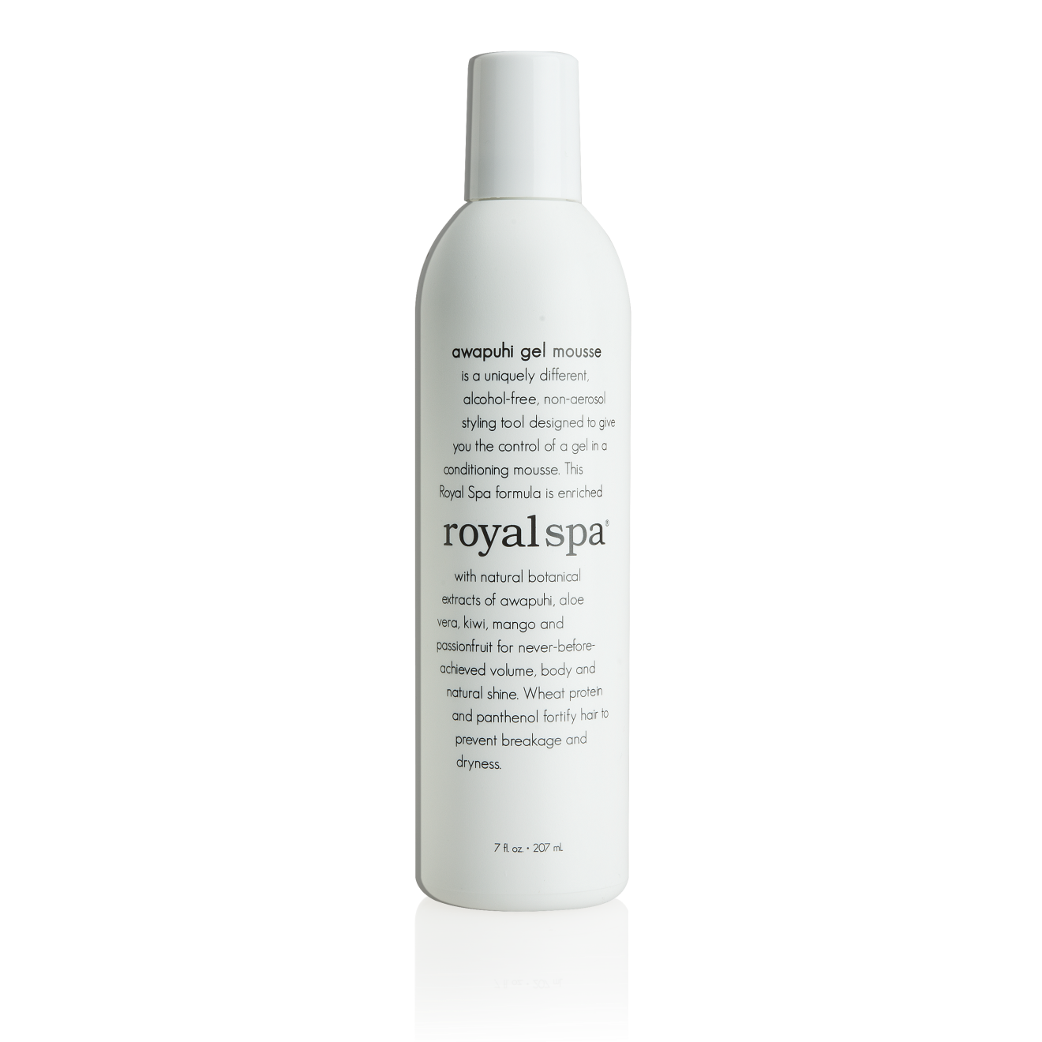

Royal SpaTM
夏威夷白姜造型泡沫
Awapuhi Mousse
Motives®保濕潤唇膏
Hydrating Lip Balm
Coming
Soon
Nocturnal Heat
224MES
Coming
Soon
SPRING | SUMMER
2016
UC:$110.00 SR:$154.00 BV:10.00
UC:$106.00 SR:$147.00 BV:5.00

Slide 15
Royal SpaTM夏威夷白姜造型泡沫
Awapuhi Mousse
Coming
Soon
Nocturnal Heat
224MES
SPRING | SUMMER
2016
UC:$106.00 SR:$147.00 BV:5.00

Slide 16
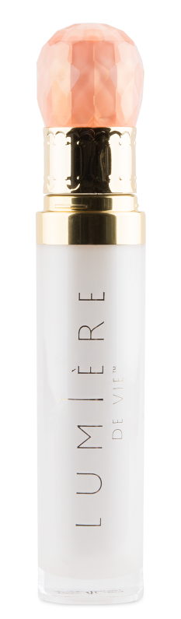

Will Or’s護膚心得
Tips for Skincare Regimen
Lumière de Vie
極緻妍亮火山泥去角質面膜
Volcanic Exfoliating Mask
Lumiere de Vie
瞬間緊緻精華液
Needle Free Serum

Slide 17


Slide 18
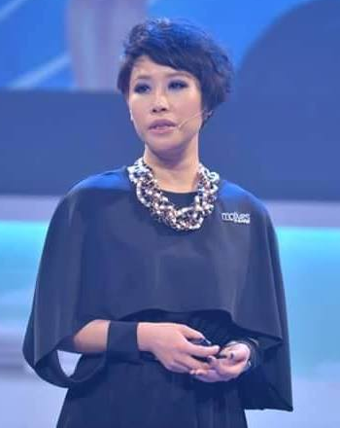
形象設計，美容及化妝導師
熱愛藝術，時裝，自7歲已開始護膚
香港設計學院修讀時裝設計
參與多個時裝表演，廣告，舞台劇，新娘化妝工作
企業儀容彩妝培訓顧問
Angie Chou
Image designer and makeup professional
Love design and fashion. Started her skincare regimen at the age of 7
Studied fashion design at Hong Kong School of Design
Act as makeup designer for fashion shows, advertisement, drama and wedding event
Makeup Beauty Consultant for Corporates
資深主管經理級
SMC

Slide 19
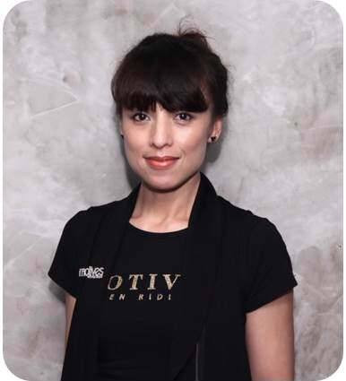
Rose Wong
從事IT管理工作
Motives®授證訓練員
Motives®挑戰賽得主
總裁挑戰賽得主
TLS®挑戰賽得主
2013最高Cashback得主
2012飛躍進步獎
Worked as IT management
Motives® Certified Trainer
Motives® Challenge Winner
President Challenge Winner
TLS® Challenge Winner
2013 MHK Cashback Award
2012 MHK Improvement Award
總顧問經理級
NSC

Slide 20
家庭收入統計
Household Income Statistics
普通消費單位
之收入及消費：
普通消費單位
之收入及消費：
HK$ 312,000
HK$ 218,400
AVERAGE
CONSUMER UNIT
CHARACTERISTICS:
AVERAGE
CONSUMER UNIT
CHARACTERISTICS:
年度消費總額
年度收入總額
年度消費總額
年度收入總額
TOTAL Annual Income
Total annual Expenditures
Total annual Expenditures
以上數據參考政府統計處 http://www.statistics.gov.hk/pub/B10500012015QQ04B0100.pdf
The above is from The Government of the Hong Kong Special Administrative Region http://www.statistics.gov.hk/pub/B10500012015QQ04B0100.pdf

Slide 21
你的每月消費與平均每月消費額比較相差多少？
食品 Food
家居 Housing
每年總消費額
Annual Total
衣著服飾
Apparel and Services
HK$103,999
交通 Transportation
How does your monthly spending compare to the average monthly spending?
保健 Healthcare
娛樂 Entertainment
平均每月消費額
Monthly Total
個人保養品及服務
Personal Care Products and Services
HK$8,667
書籍文具 Reading
雜項開銷
MISCELLANEOUS
以上數據參考政府統計處 http://www.statistics.gov.hk/pub/B10800032016MM02B0100.pdf
The above is from The Government of the Hong Kong Special Administrative Region http://www.statistics.gov.hk/pub/B10800032016MM02B0100.pdf

Slide 22
這是你的選擇
It’s Your Choice
你可以繼續消費，
幫別人、幫別的公司賺錢
你也可以透過購物年金，
轉消費為收入，幫自己賺錢
或者
OR
You can convert your spending into earning with the Shopping AnnuityTM and help yourself make money
You can continue to shop and make other companies and people money
你會選擇哪一種？
Which do you Prefer?

Slide 23




購物年金
轉消費為收入
The Shopping ANNUITYTM
Convert Spending Into Earning
Notes:
Rose

Slide 24

如何開始建立購物年金？
從改變你的購物習慣開始
How Do You Fund Your Shopping AnnuityTM?
It Begins by Adjusting
Your Shopping Behaviors
Notes:
Rose

Slide 25
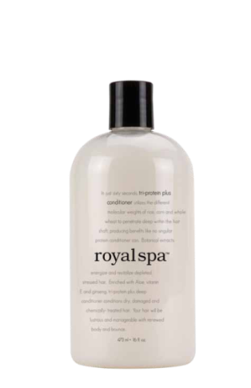
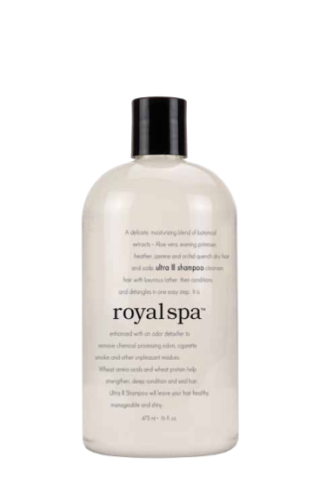
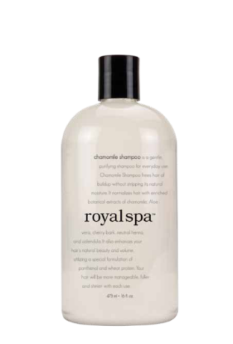
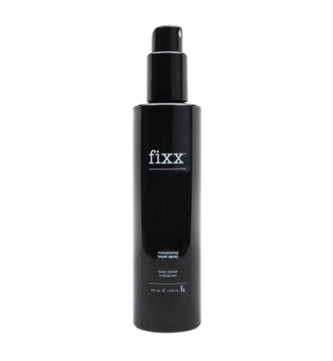








獨家代理品牌
Exclusive brands
更優質產品
更優惠價格
現金回贈
Better PRODUCTS
Better Prices
Cashback for
customers
現在就開始找出那些你可以在美安購買的
產品，並停止購買其他品牌，如此才是
真正落實購物年金。
Start identifying which of the company’s exclusive brands you could use instead of other brands to fund your Shopping Annuity™

Slide 26

1. 社交媒體
前所未有的世上最大引薦計劃
1. Social Media
The WORLD’S largest referral program
in history
Notes:
Rose

Slide 27











Motives® by Loren Ridinger彩妝系列
Notes:
Angie

Slide 28





2. Motives®美麗盛會 Event
Notes:
Rose

Slide 29
3. 會議聯盟系統 NMTSS
訓練：
MOTIVES品牌概覽、產品知識及銷售技巧
護膚及個人護理系列 產品知識及銷售技巧課程
Trainings:
MOTIVES Brand Overview, Product Knowledge and Marketing
Skin & Personal Care Product Knowledge and Marketing
Notes:
Rose:識別需要
了解品牌與眾不同之處
提供解決方案
為你賦予力量
促進行動

Slide 30




3. 會議聯盟系統 NMTSS
工作坊：
網上派對計劃及SHOPBOX技術
進階肌膚護理工作坊
臉部彩妝教學工作坊
眼部妝容工作坊
唇部彩妝工作坊
Workshop:
Online Party Program &
Shopbox Technology
Advanced Skin Solution
Flawless Face Workshop
All About Eyes Workshop
Perfect Pout Workshop
Notes:
Angie

Slide 31

27
Motives®快速起步套裝
Fast Start Kit
Notes:
Angie

Slide 32
團隊及零售增長
Growth in Team and Sales
↑20%
↑30%
MOTIVES®瑰麗化妝掃套裝
8-Piece Deluxe Brush Set
Motives®磨砂修護唇膏
Lip Pumice
↑40%
↑40%
零售
Retail
新超連鎖™店主
New UFO
Notes:
Rose

Slide 33














Motives®
授證訓練員
Certified
Trainers
Jane He
Helen Lin
Mony Ung
Reginia Wong
Rose Wong
Tammy Lui
Kero Chan
Angela Smith
Angie Chou
Claudia Chow
May Ho
Asa Ng
Pat Chan
Sandy Kam
Andy Leung

Slide 34


社交媒體
SOCIAL MEDIA
Will Or的個人社交網站
Will Or’s Personal Page, including:
SHE.COM
450,000 followers
BeautyExchange.com
651,000 followers

Slide 35

請到MOTIVES展覽攤位
VISIT THE MOTIVES BOOTH
Notes:
This image will be replaced with an image of the Motives booth that will be taken tomorrow (2-3-16)

Slide 36


